Slide 2
GREATER BOSTON LODGING MARKET 2018 & 2019
RACHEL J. ROGINSKY, ISHC PRINCIPAL rroginsky@pinnacle-advisory.com
Pinnacle Advisory Group Boston New York Newport Beach Portland Washington DC Tampa

Slide 3
HISTORIC PERFORMANCE – BOSTON SUBURBS
Since 2000
Average Occ: 64.0%
Peak: 73.3% (2000)
ADR (CAGR): 1.5%
Since Recession (‘09)
Average Occ: 66.8%
Peak: 72.5% (2015)
ADR (CAGR): 4.5%
Source: STR

Slide 4
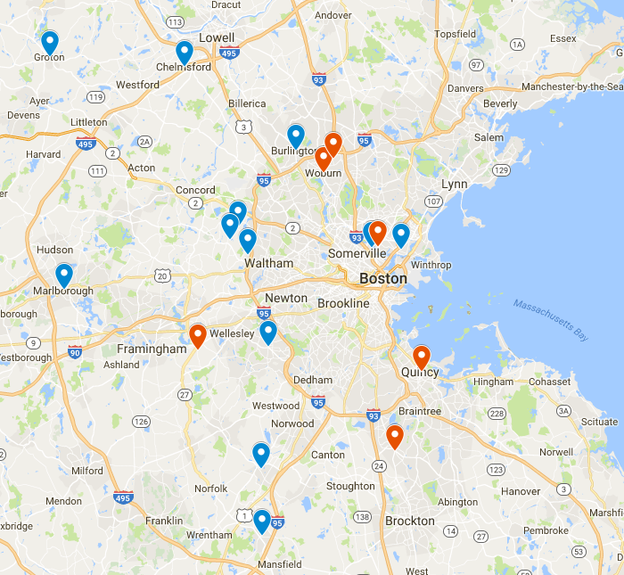
NEW SUPPLY – BOSTON SUBURBS
2018
12 New Hotels, 1,445 New Rooms
Fairly spread out
Rt-128 markets seeing largest increases, Waltham in particular (+19%)
5.6%
Supply Increase
in 2018
2019
7 New Hotels, 1,322 New Rooms
Woburn will see considerable increase with 235-room dual brand (+14%)
Encore Boston Harbor in Everett has 671 rooms!
4.3%
Supply Increase
In 2019

Slide 5
LODGING TRENDS- BOSTON SUBURBS
Strong demand growth YTD is expected to moderate by year end. A significant amount of the overall demand increases will continue to be supply driven (induced demand).
Peak corp demand should continue to fill hotels Tues/Wed. Sub markets with new supply will see fewer sellouts.
Less compression from Boston, largely due to the increases in Boston supply and the increasing prevalence of alternative lodging during peak periods.
New supply will be the primary reason for occupancy declines, demand growth will remain positive.
ADR growth has been decelerating. With older hotels fighting new hotels for business, this trend is expected to continue.
Operators throughout the burbs have indicated that their primary concerns include: new supply, the impact of Airbnb, and a labor shortage.
Encore Boston Harbor (Everett) – 3 million square foot five-star casino, 210,000 square foot gaming facility and 671 guestrooms. Anticipated opening, June 2019. Will these new rooms cut rates to take demand from existing hotels in the Burbs and in Boston?

Slide 6
SUBURBAN BOSTON PROJECTIONS 2017-2019
 | 2017 | 2018 | 2019
Occupancy | 68.5% | 69% | 67.5%
ADR | $139.70 | $139.00 | $137.61
RevPAR | $95.69 | $95.91 | $92.89
2017-2018
6.4% growth in demand!
2018-2019
2.0% growth in demand!
Source: Pinnacle Advisory Group

Slide 7
HISTORIC PERFORMANCE BOSTON CAMBRIDGE 2000-2017

Slide 8
BOSTON CAMBRIDGE NEW SUPPLY 2018
Hotel | Neighborhood | Chain Scale | Rooms | Est. Opening
Courtyard North Station | North End / Downtown | Upscale | 220 | Mar 2018
AC Hotel Ink Block | South End | Upscale | 205 | Mar 2018
Studio Allston Hotel | Allston | Indep. | 117 | Apr 2018
AC Hotel Cleveland Circle | Brighton / Brookline | Upscale | 162 | May 2018
Holiday Inn Express South Boston (Expansion) | South Boston | Upper Mid-Scale | 60 | Jul 2018
Hotel 1868 | Cambridge | Indep. | 50 | Sep 2018
Residence Inn Roxbury | Roxbury | Upscale | 135 | Nov 2018
3.1%
Supply Increase
In 2018
Source: Various Sources, Compiled by Pinnacle Advisory Group

Slide 9
BOSTON CAMBRIDGE NEW SUPPLY 2019
Hotel | Neighborhood | Chain Scale | Rooms | Est. Opening
Hyatt Centric Congress Square | Downtown | Upper Upscale | 163 | Q1
Four Seasons Back Bay | Back Bay | Luxury | 211 | Q1
Cambria South Boston | South Boston | Upscale | 159 | Q1
Moxy Theater District | Theater District | Upper Midscale (micro) | 346 | Q2
Luxury Boutique Beacon Hill | Beacon Hill | Indep. | 66 | Q2
907 Main | Cambridge | Indep. | 67 | Q3
CitizenM North Station | West End | Upscale (micro) | 269 | Q4
4.8%
Supply Increase
In 2019
Source: Various Sources, Compiled by Pinnacle Advisory Group

Slide 10
LODGING TRENDS BOSTON CAMBRIDGE
Convention – Trending down. 2017 had a high of 29 citywides representing a total of 490,000 roonights. 2018 and 2019 are pacing to be down 5% and 24%, respectively from each prior year.
Corporate - Office market is booming. 94 M SF office space in Boston and Cambridge. #1 biotech hub in US. New or expanding tenants such as GE, Amazon, WeWork, Wayfair, among others.
Logan Airport - continues its modernization campaign to boost capacity and continue its record-setting growth. Passenger traffic in 2017 reached 38.4 million, a 5.9% increase to prior year. International passenger traffic increased 9.3%. YTD through May 2018, traffic through Logan Airport has increased 5.4%. But International traffic is slowing.
Leisure – strong leisure market supported by tourism, numerous colleges, sporting events, and local/regional activities. Encore Casino, a 3 million square foot five-star casino with 625 guestrooms opening, June 2019.
ADR is expected to be flat in 2018 and to decline in 2019. While corporate volume is expected to increase, new supply and a weak convention calendar will drive rates down.
As of May 2018, supply was up 2.1%, demand was up 2.4%, occupancy was up 0.3%, ADR was down (1.9%) and RevPAR was down (1.7%).

Slide 11
BOSTON & CAMBRIDGE PROJECTIONS 2018-2019
 | 2017 | 2018 | 2019
Occupancy | 82.2% | 81.8% | 80%
ADR | $258.34 | $258.34 | $255.76
RevPAR | $212.38 | $213.44 | $204.61
2017-2018
2.6% growth in demand!
2018-2019
2.0% growth in demand!
Source: Pinnacle Advisory Group

